Slide 1

SQL PROJECT
FINANCE & SUPPLY CHAIN ANALYTICS
AT ATLIQ HARDWARES

Slide 2
TABLE OF CONTENT
About AtliQ
Business Model
PROBLEM Statement
OBJECTIVE
FINANCE ANALYTICS REPORTS
Conclusion
SUPPLY CHAIN ANALYTICS REPORTS

Slide 3
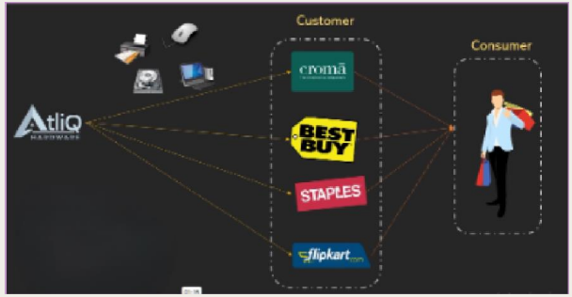
ATLIQ HARDWARE & BUSINESS MODEL
AtliQ Hardware is a distinguished global leader in electronics manufacturing, specializing in the production and distribution of an extensive range of high-quality hardware products. Our offerings include personal computers, printers, mice and a variety of other computer peripherals, serving the diverse needs of customers worldwide.

Slide 4
PROBLEM STATEMENT
AtliQ Hardware is currently facing performance challenges due to the increasing size and complexity of its Excel files. To resolve this issue, the company has appointed a dedicated team to of data analysts to leverage MySQL for extracting valuable insights and enhancing operational efficiency.

Slide 5
OBJECTIVE
The primary objective of this project is to derive actionable insights regarding sales performance, market dynamics, customer behavior, and to forecast supply chain trends.

Slide 6
FINANCE ANALYTICS

Slide 7
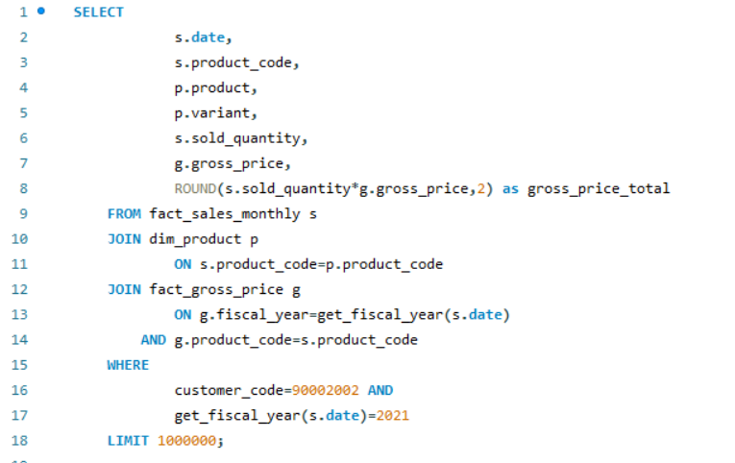
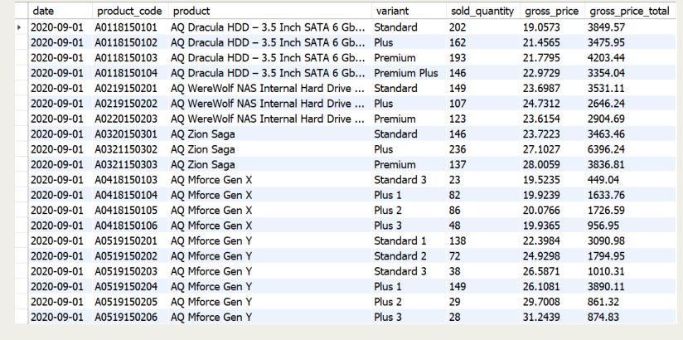
Croma sales report
Query – Generate a monthly product transactions report for Gross Sales for the FY -2021.

Slide 8
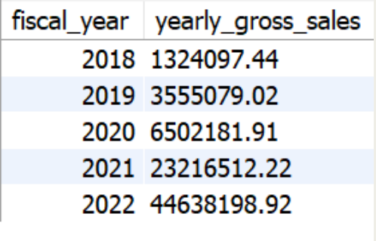
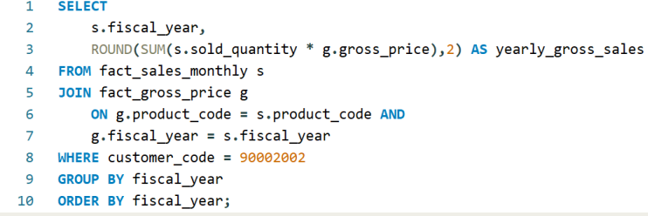
CROMA YEARLY GROSS SALES REPORT
Query - Generate a yearly report for Croma India where there are two columns -
1. Fiscal Year 2. Total Gross Sales Amount in that year from Croma.

Slide 9
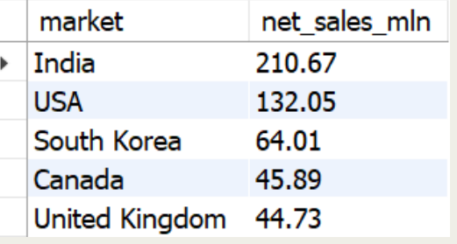
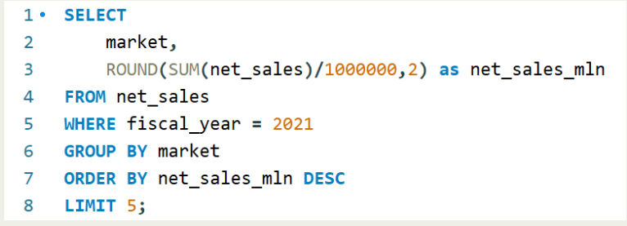
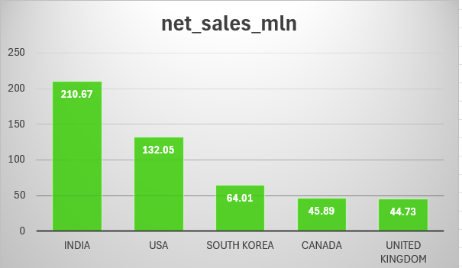
TOP 5 Markets
Query - Generate a report for getting Top 5 markets
by Net Sales in Fiscal Year 2021.

Slide 10
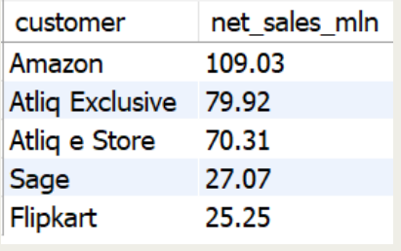
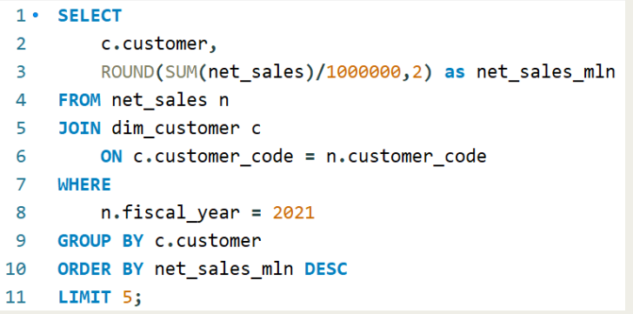
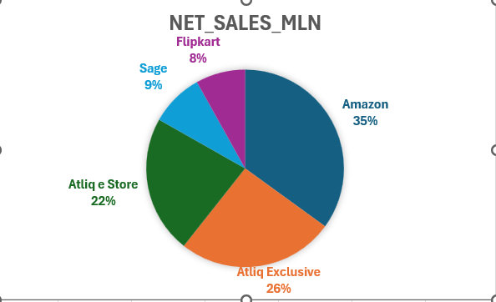
TOP 5 CUSTOMERS
Query - Generate a report getting
Top 5 customers by Net Sales in Fiscal Year 2021.

Slide 11
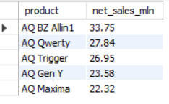
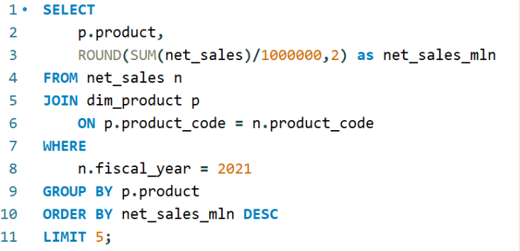
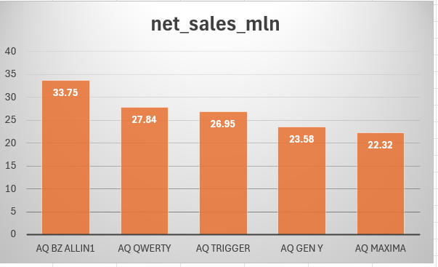
TOP 5 PRODUCTS
Query - Generate a report for getting
Top 5 products by Net Sales in Fiscal Year 2021.

Slide 12
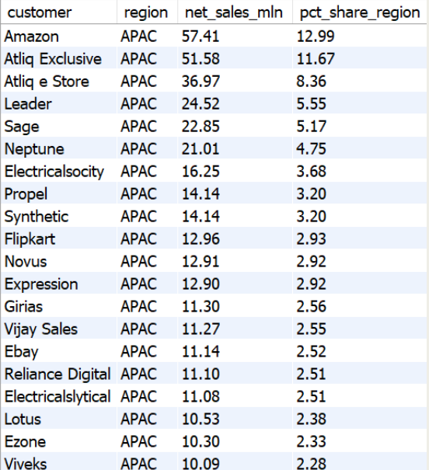
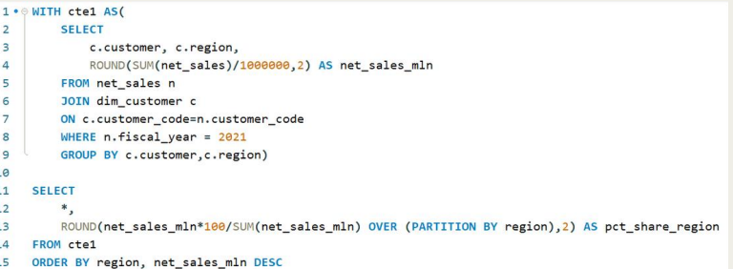
NET SALES % REPORT
Query - Generate a Net Sales% report of
Customers in different regions.

Slide 13
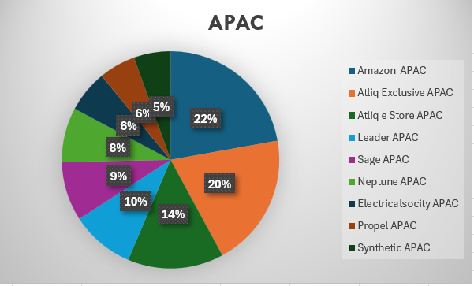
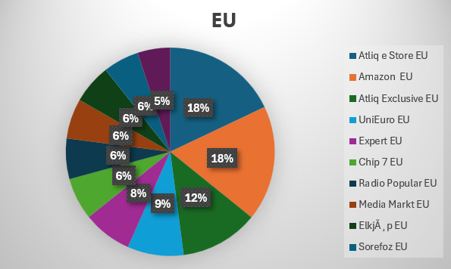
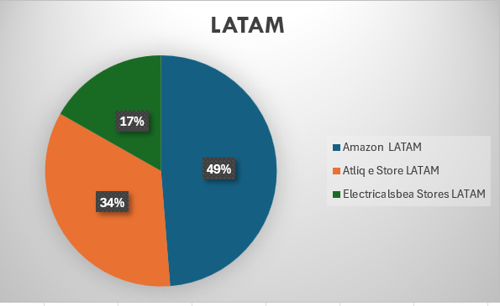
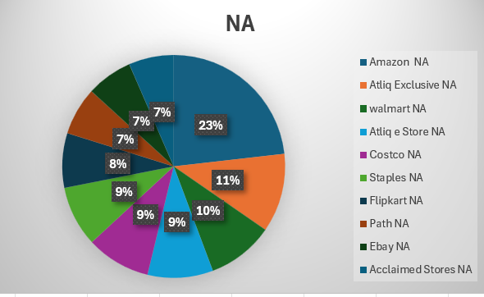
MARKET SHARE %
Query- Top Customers in different Regions.

Slide 14
CONCLUSION
AtliQ Hardware achieved record sales in 2022.
India was the largest market in 2021 with sales of $210.67 M.
Amazon generated the highest net sales in 2021 with $109.03 M.
The AQ BZ all-in-one was the top-selling product in 2021 with the sales of $33.75 M.
Amazon captures the top market share% in APAC, LATAM & NA regions.
AtliQ e store topped the chart in EU region.

Slide 15
SUPPLY CHAIN ANALYTICS

Slide 16
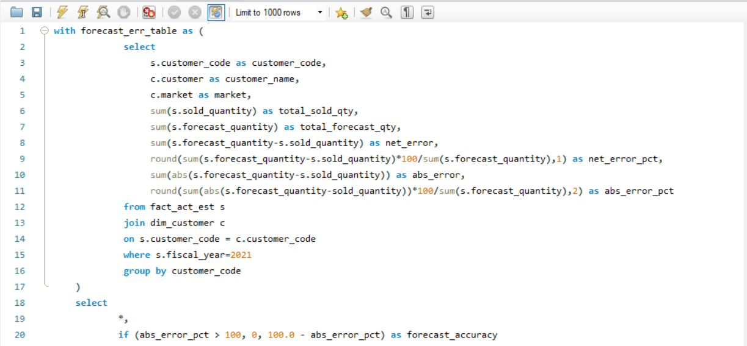
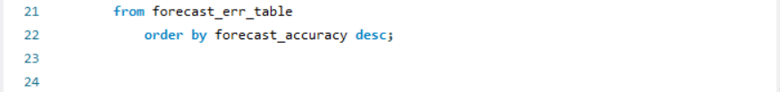
FORECAST ACCURACY REPORT
Query- Generate a Forecast Accuracy Report for all the customers for the FY-2021.

Slide 17
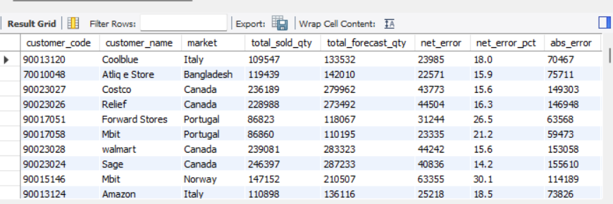
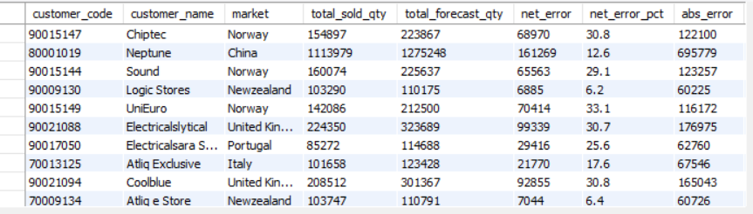
FORECAST ACCURACY REPORT-2021

Slide 18
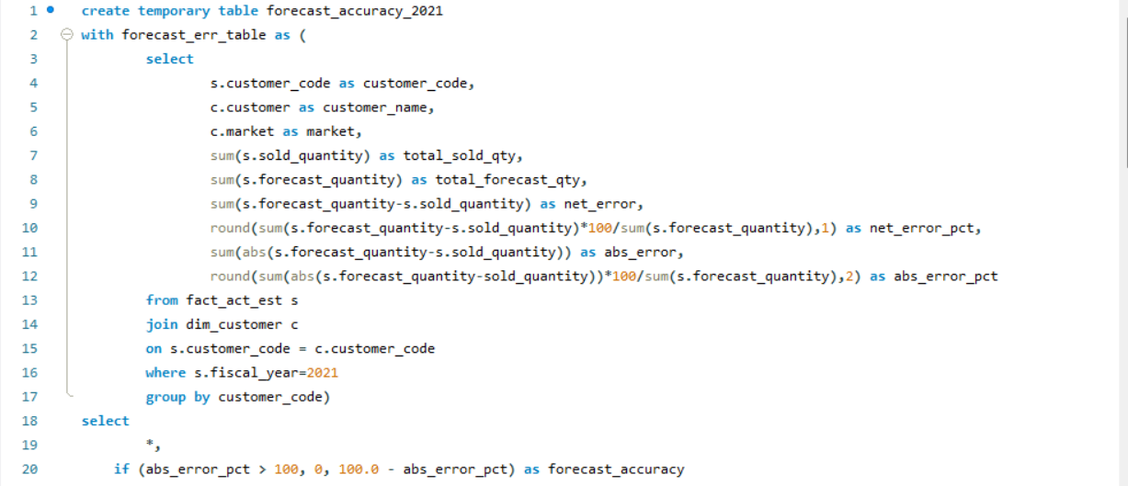
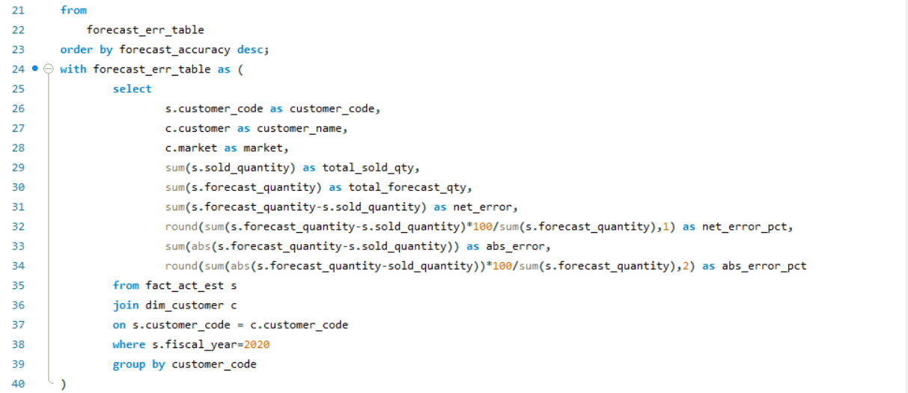
FORECAST ACCURACY REPORT 2021 VS 2020
Query- Generate a report showing forecast accuracy for all customers for FY-2021 vs FY-2020

Slide 19
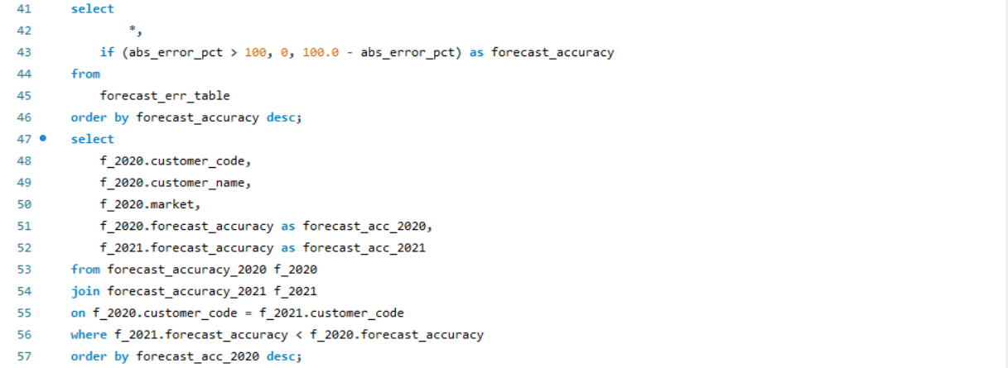
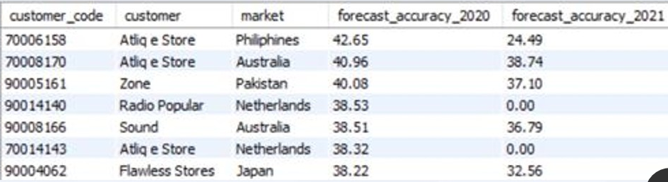

Slide 20
THANKYOU !
- Presented by
Sharanya Shukla

